Slide 1
Big Data Course Project
Topic given: Data Science and Machine Learning Project Task given: Apply ML Algorithm to Dataset
Task chosen: Recognize Handwriting using CNN + RNN with Keras and TensorFlow package
Presentation by, Name: Surya Narayanan S Reg No: 121015098 Dept: Information Technology
Year: 4th year

Slide 2
Index
Abstract
Visualize dataset
Pre-process Images
Model Pipeline
Training, Testing, Evaluation of Model

Slide 3
Abstract
Task chosen: Recognize Handwriting using CNN + RNN with Keras and TensorFlow package
Dataset: https://www.kaggle.com/landlord/handwriting-recognition
Dataset size: 1.3 GB
No of Images: 3.72 Lakhs
A CRNN (Convolutional Neural Network + Recurrent Neural Network) Machine Learning Model is built to recognize and convert Handwritten Images to text using TensorFlow and Keras package in python.
This model is used to predict handwritten images to its equivalent text.
After predicting, accuracy of characters and words are used for evaluation.

Slide 4
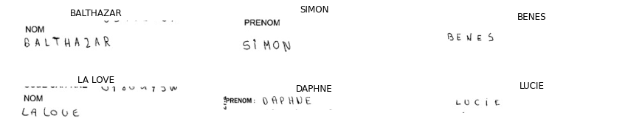
What data do we have ?
Sample 6 Images
Dataset Consists of 1 lakhs Images
Handwritten Text Images
Inference:
Black and White Image
Characters are black
Characters are very thin
Image has some prefix like (Prenom and Nom (other than handwritten))

Slide 5
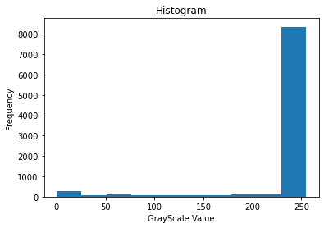
Visualize the Image Distribution
Histogram of a sample Image
Inference:
Pixel values are between 0 and 255
Towards zero (0) is black colour.
Foreground(Character) is black and very few pixels less than 1000) contribute to character.
Towards 255 is white colour.
Background is white and more than 8000 pixels contribute to background
In-between 0 and 255, all the pixels contribute noise to image

Slide 6
Pre-processing Dataset (Excel file)
Remove rows with No Labels (NaN) (Null Cells).
Remove rows that has labelled as ‘UNREADABLE’.
Convert all Labels to Upper Case Characters.
Map all characters to Numbers between 0 and 25 to construct the model easily.

Slide 7

Pre-process Image
Convert image to Grayscale(Black and White),
Make High contrast. This makes the Image have more foreground pixels which makes the model predict easily.
Convert all the images to a fixed size (Height and Width). This makes the Input for the Model Uniform
Rotate Image to 90 degree. This makes the model predict the first character, first.
Before Pre-processing (Sample Image):
After Pre-processing Image (Sample Image)(Black Image) :

Slide 8
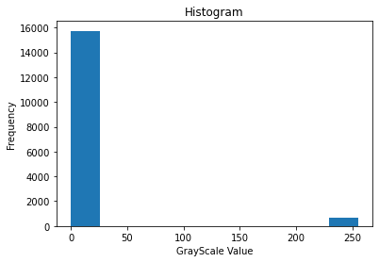
After Pre-processing, Histogram
Histogram of processed Sample Image.
The Noisy pixels are eliminated
by converting them either
to pure black or pure white pixels.
Now, White pixels are Characters.
Black pixels are Background.
The Number of Pixels that represent Character is increased to more than 1000 pixels from less than 1000 pixels. This makes the prediction more accurate.

Slide 9
Pipeline of Model
Pre-processed Image (Input)
Convolve Feature
Batch Normalization
RELU Activation
Max Pooling
Dropout 30%
Dense (Dimensionality Reduction)
LSTM
Dense
SoftMax Activation
CTC Loss (Output)

Slide 10
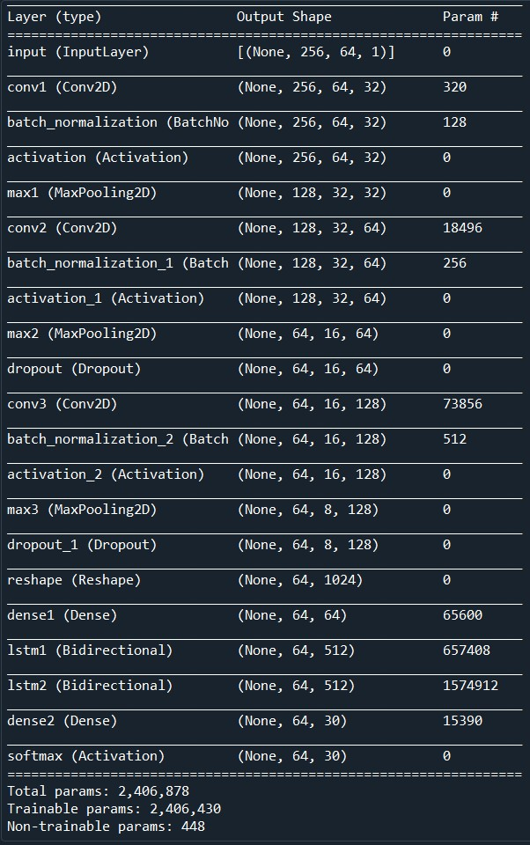
Summary of Model

Slide 11


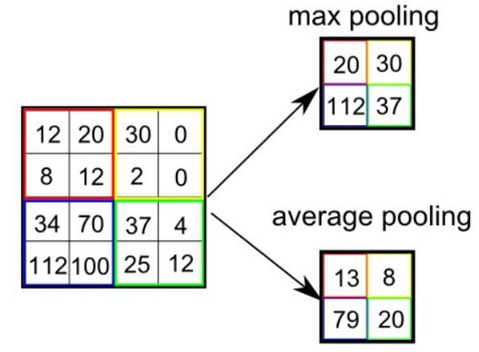
Convolution + Pooling Explained
Max Pooling
Convolution Filter
Convolution is a Feature Extraction process. They use Filter Kernels to extract important features in the image.
Pooling is a Dimensionality Reduction Process. It reduces the Dimension, yet conserving important features.
Here, a sample image is convolved and pooled for example.

Slide 12
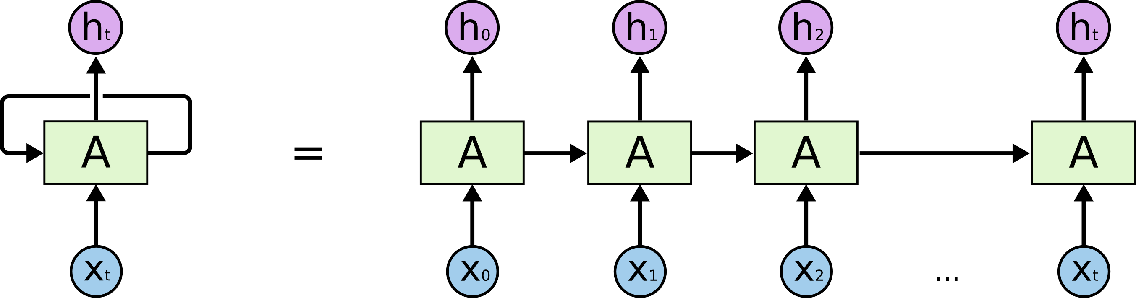
LSTM - RNN
LSTM - Long Short Term Memory - Recurrent Neural network
A RNN - multiple copies of the same network, each passing a message to a successor.
LSTM - capable of learning long-term dependencies.
Remembering information for long periods of time

Slide 13
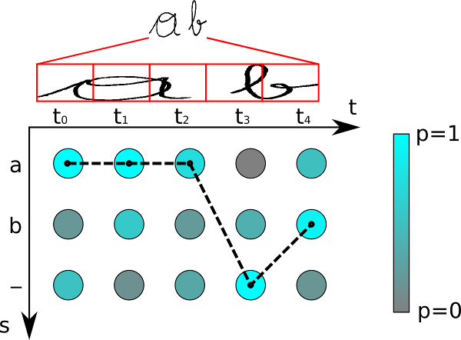
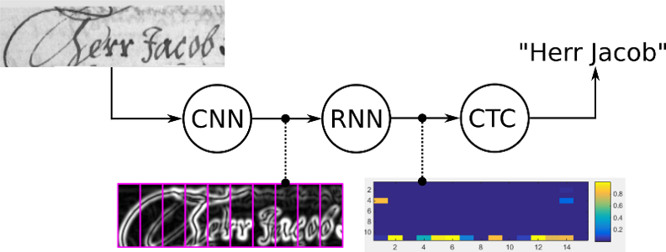
CTC Loss Output
CTC – Connectionist Temporal Classification
train: calculate the loss value to train the NN
infer: decode the matrix to get the text contained in the input image
we only have to tell the CTC loss function the text that occurs in the image. Therefore we ignore both the position and width of the characters in the image.

Slide 14
Evaluation of CRNN Model
Fitted – with 30K Images.
It took nearly 5 hours to train the model.
60 epochs , each 30K images.
Made use of GPU for Image processing.
Without High Contrast, the model gave an accuracy of 85% of character prediction accuracy
With using High Contrast colours, it gave 91% accuracy

Slide 15
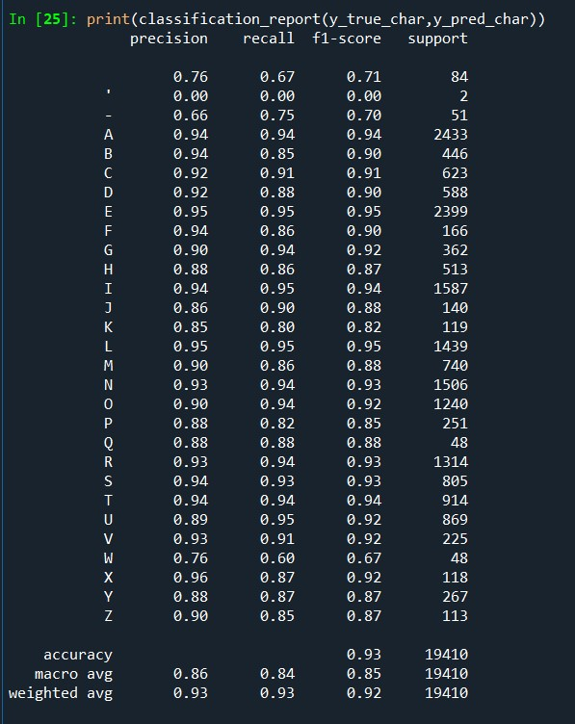
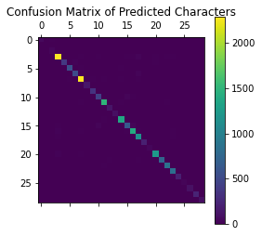

Classification Report (3000 Images)

Slide 16
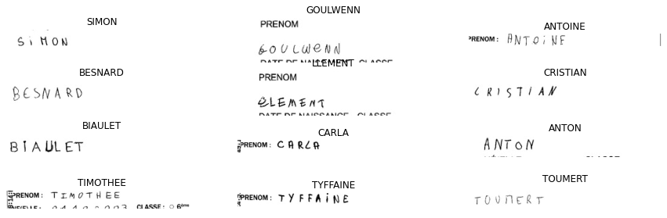
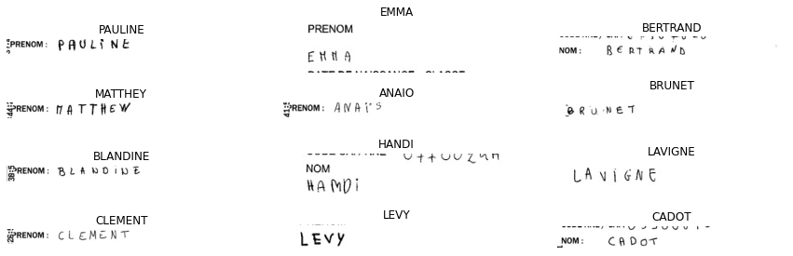
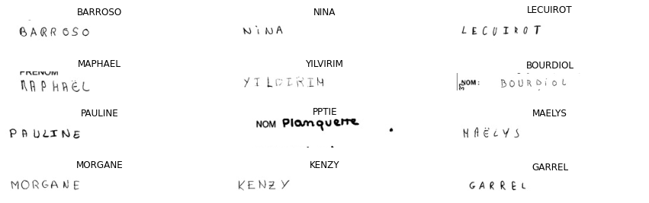
Sample Predicted Output

Slide 17
References
https://towardsdatascience.com/a-comprehensive-guide-to-convolutional-neural-networks-the-eli5-way-3bd2b1164a53
https://colah.github.io/posts/2015-08-Understanding-LSTMs/
https://towardsdatascience.com/intuitively-understanding-connectionist-temporal-classification-3797e43a86c
https://www.kaggle.com/landlord/handwriting-recognition

Slide 18
Thank You

